Slide 1
PHY 1002 Physics Laboratory
SK Hark
( Xiao Bowen, Zhu Xi, Wang Lu, and Ling Han modified for Term 1 AY2021/22)

Slide 2
Contents
Course Outline
Assessment Scheme
List of experiments
Schedule of labs
Preparations for the experiments
What to do in the lab
Introduction on the PASCO Mechanics Set
Formal/Short Reports
Introduction to error analysis

Slide 3
Course outline
Hands-on Practices of experiments (PHY 1001 Mechanics)
Centripetal and Gravitational Forces
Conservation Laws: momentum, angular momentum, and energy
Periodic motions: pendulum, damped harmonic oscillator, and resonator
Scientific Report Writing
Introduction: Why you are doing this exp?
Methods of measurement: How?
Results and Discussions: what do you find? Handling and analyzing scientific data and their inaccuracies
Notes:
This course provides hands-on practice for students to perform experiments in mechanics. These experiments are selected to show how centripetal and gravitational forces are measured; to validate the conservation laws of mechanics, such as that of momentum, angular momentum and energy; and to demonstrate those phenomena that occur in periodic motions, such as in a pendulum, damped harmonic oscillator, and resonator.
This course also trains students to write scientific reports (Your future goal is write a journal paper like this), present their methods of measurements and findings in a generally accepted style, including properly handling and analyzing scientific data and their inaccuracies.

Slide 4
Course outline
Course activities
Read the lab manual, understand what you are going to do.
Once you are in the lab, you are on your own.
Formal and Informal (or short) Reports are required for different Exp.
Estimation of time needed
Activity | Hours/Lab
Prelab reading of lab manual | 1 hour/lab
Lab practice | 3 hour/lab
Lab report writing (average) | 1 hour/lab

Slide 5
List of experiments
One set of exercise on error analysis
Eight mechanics experiments
Some easier, some harder; some takes longer time, some shorter.
No | Experiment | Report
1 | Centripetal Force | Short
2 | Large Amplitude Pendulum | Formal
3 | Conservation of Momentum | Short
4 | Rotational Inertia (Physical Pendulum) | Short
5 | Conservation of Angular Momentum | Formal
6 | Conservation of Energy (Ballistic Pendulum) | Short
7 | Resonance Air Column with Speaker | Short
8 | Driven Damped Harmonic Oscillations | Formal
Notes:
New order

Slide 6
Assessment Scheme
Component | weight
Exercise | 10/110
First Formal Lab Report + 5 Short Lab Reports 10 each | 60/110
2 Formal Lab Reports 20 each | 40/110
Total is 110/110

Slide 7
Schedule of lab classes
Date | Week | Lab days
Sept 6-10 | 1 | No class/lab.
Sept 13-17 | 2 | Lecture on guidelines and data analysis.
Sept 18-26 | 3 | 1st lab (Sept 18 for Mon. sessions, Sept 26 for Tue. Session). Error analysis assignment due (Oct 8 23:59).
Sept 27- Oct 8 | 4-5 | No lab, 1st report due.
Oct 11-15 | 6 | Lecture: Feedback on reports submitted.
Oct 18-22 | 7 | 2nd lab.
Oct 25-29 | 8 | 3rd lab, 2nd report due.
Nov 1-5 | 9 | No lab (midterm break, tentative)
Nov 8-12 | 10 | 4th lab, 3rd report due.
Nov 15-19 | 11 | 5th lab, 4th report due.
Nov 22-26 | 12 | 6th lab, 5th report due
Nov 29 – Dec 3 | 13 | 7th lab, 6th report due.
Dec 6-10 | 14 | 8th lab, 7th report due.
Dec 13-17 | 15 | No lab. Due for 2nd & 3rd formal report (Dec 17 23:59).
Typhoon or rainstorm, make-up on Saturday Morning
Filled make-up application form on Blackboard before Fri. 5pm the Saturday make-up.
All reports and error analysis homework should be submitted on Blackboard
Midterm term break and following lab schedules are tentative, will finalize when your mid-term dates are known
For your 1st formal report and all short report, you have 7 days to write your report. For example, the start time of your lab session is Thu. 8:30, the deadline of your report submission is next Thu. 8:30.
The deadline for 2nd &3rd formal report is Dec 17 23:59.
SIGN your name on atte ndance sheet once you enter the lab, no grade for report if you absent.

Slide 8
Instructors
CD: Cheng Dao; ZX: Zhi Xin; ZR: Zhi Ren; DY: Dao Yuan;
HB: Harmonia Block B; RB: Research Building B; TC: Teaching Building C
Name | Remark | email | Office | Office Hours | Role
XIAO Bowen | L3 session | xiaobowen@cuhk.edu.cn | RA 404 | Wed afternoon | Instructor
LING Han | L1 session | linghan@cuhk.edu.cn | HB202 | Tue. 10:30-11:30 | Instructor
WANG LU | L2 session | lwang@cuhk.edu.cn | RA311 | Thu. 9:00-10:00 | Instructor
ZHU Xi | L4, L5 sessions | zhuxi@cuhk.edu.cn | CD406 | Appointment by email | Instructor
CHEN Wei Ye, Edward | Phone: 84273860 | chenweiye@cuhk.edu.cn | ZX 303 | N.A. | Lab Engineer
YE Shuqian | L3 session, Mark exp3 | shuqianye@link.cuhk.edu.cn | ZR 503 | Thu. 13:00-14:00 | Leading TA
LIU Rulin | L2, L4 sessions, Mark exp8 | rulinliu@link.cuhk.edu.cn | ZR 503 | Thu. 13:00-14:00 | TA
LI Jie | L1, L5 sessions, Mark exp2 | jieli1@link.cuhk.edu.cn | ZR 502 | Fri. 13:00-14:00 | TA
LU Zhe | L1, L2, L3 sessions | 221019125@link.chuk.edu.cn | TC 401 | Thu. 13:00-14:00 | TA
ZHOU Yuqing | L1 session, Mark exp1,5,7 | 220019133@link.chuk.edu.cn | RB 506 | Mon. 14:00-15:00 | TA
XU Yanheng | L2, L4 sessions, Mark exp4,6 | yanhengxu@link.cuhk.edu.cn | ZR 503 | Tue. 9:30-10:30 | TA
LIN Xinyu | L2, L3 sessions, Mark error analysis assignment | xinyulin@link.cuhk.edu.cn | DY 322 | Wed 13:00-14:00 | TA

Slide 9
Your lab schedule
Each student will be assigned to a group, the group information will be released on Blackboard after add/drop period.
Take turns in a round robin fashion, following the lab class schedule.
Everyone does 8 experiments and writes 3 formal and 5 short reports. Only the sequence differs.
Group | W2 | W3 | W4-5 | W6 | W7 | W8 | W9 | W10 | W11 | W12 | W13 | W14
1 | Lec | Exp1 | No Lab | Lec | Exp2 | Exp3 | No Lab | Exp4 | Exp5 | Exp6 | Exp7 | Exp8
2 |  | Exp2 |  |  | Exp3 | Exp4 |  | Exp5 | Exp6 | Exp7 | Exp8 | Exp1
3 |  | Exp3 |  |  | Exp4 | Exp5 |  | Exp6 | Exp7 | Exp8 | Exp1 | Exp2
4 |  | Exp4 |  |  | Exp5 | Exp6 |  | Exp7 | Exp8 | Exp1 | Exp2 | Exp3
5 |  | Exp5 |  |  | Exp6 | Exp7 |  | Exp8 | Exp1 | Exp2 | Exp3 | Exp4
6 |  | Exp6 |  |  | Exp7 | Exp8 |  | Exp1 | Exp2 | Exp3 | Exp4 | Exp5
7 |  | Exp7 |  |  | Exp8 | Exp1 |  | Exp2 | Exp3 | Exp4 | Exp5 | Exp6
8 |  | Exp8 |  |  | Exp1 | Exp2 |  | Exp3 | Exp4 | Exp5 | Exp6 | Exp7

Slide 10
Preparations for the experiments
Download from Blackboard the Instruction Manual for your next experiment.
Read and understand what to do before coming to the lab.
There will NOT be instructions from the teacher or TA on how to perform the experiments. You are on your own!
If you prefer you may want to download and install the CAPSTONE software on your own computer and read the instructions there.
A USB drive is handy for storing the instructions and your data.
What you see in the CAPSTONE is exactly what you will see in the lab.

Slide 11
What to do in the lab
Go to the station where your experiment is, located in Chengdao 518/519
There will be 8 Working stations, pick any one. It is first come first serve.
On the bench and in the cabinet , you will find all you need for the experiment ( small items are placed inside a plastic box).
Turn on the PC and log in using your user name and password.
Log in Blackboard to download the CAPSTONE files of your experiment, if you don’t already have it in your USB finger or notebook.
Click and open the file,
Check that you have all the necessary equipment
Follow the instructions therein to perform the experiment

Slide 12
What to do in the lab
Whenever you have a problem, raise you hand, not yell, to ask for help from the instructor or TAs on duty. The instructor will only stay in the lab during the first hour; the TAs will stay throughout the lab.
Discussion with your fellow students is allowed; but copying data or having them doing the experiment for you is not.
After you finish the measurement, remember to save your raw data. There is no guarantee that your data will be there for you forever in the lab PC. You should save your data or any information you wish to keep, in addition, to your USB driver, or transfer them to a more secure medium that you might have.
Finish your lab within the specified time. If you can’t, provide reasonable excuses, and send filled make-up lab application form to leading TA to perform a make-up.

Slide 13
What NOT to do in the lab
No use of cellphones in the lab. Cellphones must be in silent mode.
If you must use your cellphone, go out of the lab.
No chatting, no shouting, no running.
No make-up experiment for absence without approval.
Apply for permission of absence from the instructor before your lab class, except for unforeseeable reasons. Application does not imply approval. (Medical report is required)
Apply as early as possible. Give the instructor at least 18 hours to consider your application and give you a reply. If you apply too late, you must assume the approval is denied.
Notes:
Medical report is required.

Slide 14
Lab safety!!!
Take Care of yourself!!!
Do not stare at a laser beam directly
Do not wear a tie.
Bundle up your long hair.
There are moving and rotating mechanical devices in the lab that might caught your tie or hair by accident.
Do not insert any foreign objects into the electrical outlets.
Power off all equipment , including the PC and the monitor, when you are done with the experiment.

Slide 15
After the experiment
If you finish the experiment early, you are allowed to leave the lab or stay in the lab to analyze your data and write the lab report quietly.
Otherwise, take your data home to do them.
Lab report is due before the start of the next experiment. Submit all reports on Blockboard.
All reports will be graded accordingly.
Notes:
How to grade the lab reports? How many reports will be graded?

Slide 16
PASCO Mechanics Set
Measurements are carried out by sensors, which convert the measurements into voltage outputs
The voltages are digitized by a ADC (analog to digital converter)
The digitized data of the sensors are transmitted through an interface to a computer in whose disk these data are stored
The computer also controls the settings of the sensor and data acquisition through the same interface via a programme called CAPSTONE
Sensors: force, speeds (linear and rotational), angle, time (frequency), sound level
Universal interface 550 or 850, depending on the experiment
Data acquisition and analysis software CAPSTONE
Documents: PASCO Capstone User's Guide, 550-Universal-Interface-Reference-Guide-UI-5001, 850-Universal-Interface-Manual-UI-5000, Sound-Sensor-Manual-CI-6506B, PASPORT-Force-Sensor-Manual-PS-2104, Rotary-Motion-Sensor-Manual-PS-2120A, Photogate-Head-Manual-ME-9498A

Slide 17
Sensor specifications
Best specs provided by the manufacturer (Pasco)
Sensor | Model # | resolution | range
Force | PS-2104 | ±0.03 N | ±45 N
Rotary Motion | PS-21210A | ±0.09º (angular); ±0.02 mm (linear) at 4000 points per revolution | 360º
Sound Sensor | CI-6506B | ±2 db, ±0.5 Hz | 45 to 100 db
Timing (Photogate) | ME-9498A | ±0.1 ms (time), ±1 mm (spatial)
Your experimental resolution may depend on sampling or digitizing rate and software settings . One does not always set the highest resolution.

Slide 18
Universal Interface
Best Specs provided by the manufacturer
Actual sampling rate depends on sensor
Actual signal resolution depends on software settings of gain
 | 550 (UI-5501) | 850 (UI5000)
Analog range | ±10V | ±20V
Analog gain | 1X, 10X, 100X | 1X, 10X, 100X, 1000X
Max sampling rate | 1 MHz | 10 MHz
Resolution (ADC) | 14-bit (1.22 mV ) | 14 bit (2.5 mV)
Notes:
What does it mean? Need to check with machine and settings

Slide 19
Guidelines on writing a lab report
Precise and concise
Write legibly or type on A4 size papers, stapled
Title page: Name of experiment, name of student and number, date
Introduction: Describe succinctly what the experiment is about and the background theory
Methods/Procedure:
This section should demonstrate your understanding of exactly what you measured, how you measured it, and why this measurement helps you answer the question you posed in the objective section.
What you did, how you did it, and what were used.
Give enough detail that your peers could repeat your experiment .
Essay style and in past tense, not step by step instructions (do not merely copy what is in the manual)
Source: www.aplusphysics.com
Notes:
concise
kənˈsʌɪs/
adjective
adjective: concise; comparative adjective: conciser; superlative adjective: concisest
giving a lot of information clearly and in a few words; brief but comprehensive.
succinctly
səkˈsɪŋ(k)tli/
adverb
adverb: succinctly
in a brief and clearly expressed manner.

Slide 20
Guidelines on writing a lab report
Results/Data
Put your raw data into tables or graphs.
List data in the form of x±δx, where δx is the estimated error.
Show error bar of data in graphs.
For derived quantities, show propagated error too.
Units of all quantities must be indicated.
In graphs, label the axes, provide title of what you are plotting.
Explain the contents of the tables or graphs.

Slide 21
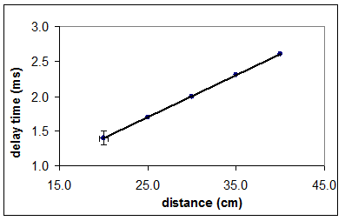
Guidelines on writing a lab report
Example of a table and a graph
Concentration changes with time. Inset: Times of detection at various distances

Slide 22
Guidelines on writing a lab report
Discussion / Analysis
State key findings
Support the findings with data
Provide logical deductions of the findings
Discuss the importance, correctness when compared to known results or theoretical models, source of errors, etc, of your findings.
Conclusions
Summarize what you learned from the experiment, with specific reference to the physical concepts under study
References and Appendices
If there is any, put long or detailed calculations here too

Slide 23
Standards of Evaluation of Reports
I. Introduction（5%）
Clearly and concisely describe the experiment.
Show good understanding of theory, process and purpose of the experiment.
Essay written in your own words, not copied from internet or Capstone.
II. Theory（10%）
Show good understanding of the meanings and implications of equations.
Write equations using the equation editor of Word, or a similar software.
Show the derivations, if necessary, of the equations from fundamental laws.

Slide 24
Standards of Evaluation of Reports
III. Experimental Data（20%）
All experimental data, raw and derived, and figures and plots, should be shown here.
The data and figures should be shown in a way to support the findings of the experiment.
IV. Data and Error Analyses（50%）
Process the raw data and present them in a way to show how your conclusions may be drawn from them.
Steps involved in the process leading to the final results should be shown .
Show all the errors of data, back from which the precision and accuracy of final results can be traced.
It’s better to have a concise description of the source of data .
Discuss the reasons why your results deviate, if they do, from the predictions of theory.
Notes:
Concise: brief but comprehensive

Slide 25
Standards of Evaluation of Reports
V. Conclusions（15%）
A concise and precise paragraph to sum up all the important points of the experiment.
Summarize the theory, methods, key results and findings
VI. Discussion for this experiment (Optional bonus item)
Some suggestions on how to improve the accuracy of this experiment.
Extensions of this experiment.

Slide 26
Brief Intro to error analysis
Introduction
Everyone makes mistakes!
In doing a physics experiment, even though you have not made any mistake, your results could still be subject to experimental errors.
Experimental error does not mean “mistake”. It actually means uncertainty.
To avoid human uncertainty, we usually do an experiment with the help of suitable equipment (e.g. ruler, multi-meter, power supply, CRO, etc.). These equipment have limitations of capabilities and therefore no measurement is exactly correct.
Experimental error is inevitable (unavoidable)!
Notes:
unavoidable

Slide 27
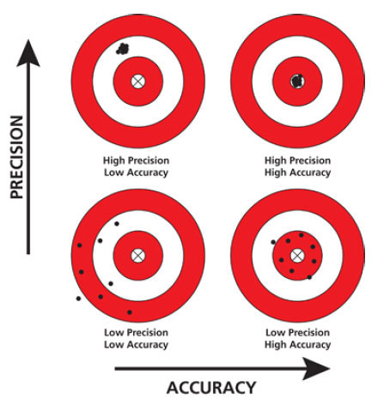
Accuracy and Precision
The accuracy of a measurement tells how close (correct) it comes to the true (accepted) value. True values are not known, especially when doing a completely new experiment.
Precision refers to the agreement among repeated measurements – that is, how close they are in values.
High precision does not necessarily imply accuracy.
Obtaining greater accuracy relies on minimizing systematic errors.
Obtaining greater precision relies on minimizing random errors.
Notes:
准确性与精确性

Slide 28
Significant Figures
The number of significant figures in a reported value is the number of digits for which the experimenter has confidence that they are correct within experimental errors.
Drop all insignificant figures from reported numbers.
Examples:
(a) 3456; (b) 135700; (c) 0.003043; (d) 0.01000; (e) 1050.; (f) 1.034; (g) 0.0002608.
The numbers above have ____ significant figures.
Zeros on the left are never significant.
00 in (b) is insignificant (no decimal point).
Last 0 in (e) is significant (decimal point).
in (d), 00 on the left is insignificant; but 000 on the right is significant.
Report (c) in scientific notation as 3.043x10⁻³ (g) as 2.608x10⁻⁴ instead.
4

Slide 29
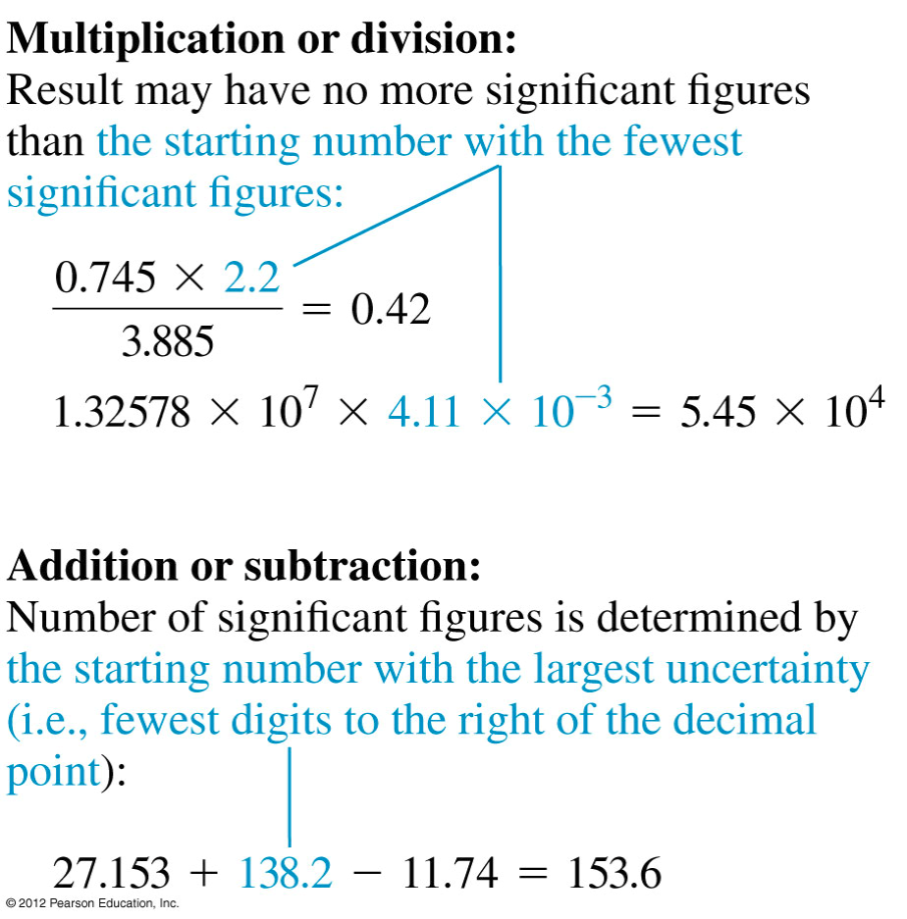
Significant Figures

Slide 30
Nature of Experimental errors
Experimental errors generally can be classified as being of two types:
(1) Systematic, which increase or decrease all measurements of a quantity in the same sense (either all measurements will tend to be too large or tend to be too small when compared to its true value);
(2) Random, sometimes larger, sometimes smaller; occurs in an unpredictable way. Random errors, can be caused by limited precision of instrumental readings.

Slide 31
Nature of Experimental errors
Sources of experimental errors
1. Real mistake: It may be due to malfunction of the equipment, wrong design of the experimental setup, careless operation of equipment, wrong procedure,…etc.
We should avoid real mistake by careful planning of the experiment and proper operation of the equipment.
2. Instrumental error: It comes from the limitations (precision, reliability and reproducibility) of equipment and tools used in the experiment.
(a) Analog equipment:
Depending on how careful you take the reading, the precision of the result can be anywhere from one-half to one-fifth of the smallest division (resolution) of the scale used is taken customarily as the estimate of the precision.
Notes:
malfunction
malˈfʌŋ(k)ʃ(ə)n/
verb
1.(of a piece of equipment or machinery) fail to function normally.

Slide 32

Nature of Experimental errors
e.g. 1 For the analog scale shown below, the reading is recorded as $2.14±0.05$cm.
e.g. 2 A meter sticker or measuring tape is generally accurate to 0.5 mm (half of the smallest graduations/divisions)
If the precision is not explicitly given, it is assumed that the error in the last digit is $±$0.5.
e.g. 1.3 means 1.3 $±$ 0.5; 1.30 $±$ 0.05
This practice is discouraged!
Notes:
explicitly
ɛkˈsplɪsɪtli/
adverb
in a clear and detailed manner, leaving no room for confusion or doubt.
"the essay should state explicitly how the facts support the thesis"

Slide 33
Nature of Experimental errors
(b) Digital equipment:
Equipment usually comes with a manual in which its capability and precision are listed in the “specifications”.
Take a digital multi-meter as an example. According to its manual, the error of a DC voltage reading is “% of reading + 1 digit)”.
This includes two types of errors (to be explained in 4 and 5 below):
(i) Systematic error: “ % of reading”
The manufacturer did a generic calibration to guarantee such a precision or accuracy.
(ii) Random error: “+ 1 digit”
It is due to internal fluctuations of electronics
“1 digit” actually means one least significant digit or the last digit of the display.

Slide 34
Nature of Experimental errors
e.g. For a specification of For instance, “± 0.1% of reading + 1 digit”
If the reading on the display is “18.5”, then “5” is the least significant digit and the error of data is (18.5×0.1%) + 0.1 ≅ 0.1. The former makes negligible contribution.
If the reading on the display is 118.5 then its error is (118.5×0.1%) + 0.1 ≅ 0.2. The former now makes a difference.
For another model, the uncertainty for voltage is given as “± 0.5% of reading + 2 digits)”. If the reading is 45.7 mV, then the error is (0.2+0.2)mV=0.4 mV.
The instrument errors are intrinsic
You measurements can not be more precise than the instrument errors
There is a trade off between precision of and time spent doing the experiment
Whenever possible, use the most sensitive scale of equipment
Notes:
negligible
ˈnɛɡlɪdʒɪb(ə)l/
adjective
adjective: negligible
so small or unimportant as to be not worth considering; insignificant.
intrinsic
ɪnˈtrɪnsɪk/
adjective
belonging naturally; essential.

Slide 35
Nature of Experimental errors
3. Human error: It may come from the uncertainty in visual judgment and human response if we need to do so in the measurements.
e.g. 1: In a free fall experiment, we use a measuring tape to measure the height (d) from which a ball is dropped. The tape has a precision of 0.5 mm. However, the experimental error will be larger than 0.5 mm, because in the measurement process, we need to judge where the end points are. Furthermore, if we use a stopwatch to measure the falling time (t), our reaction time will significantly increase the error.
e.g. 2: In a geometric optics experiment, it is difficult to judge the position of an image precisely.
To avoid human uncertainty, always try to design an experiment using only digital equipment for measurements.
Human uncertainty can result in both systematic error and random error.

Slide 36
Nature of Experimental errors
4. Systematic error: It may come from
persistent biased human observations;
uncalibrated equipment;
faulty technique (e.g. misalignment in an optics experiment);
drifting of lab environment;
simplification in analysis;
others ….
e.g. 1: In doing a free fall experiment, your stopwatch may run constantly faster. Then your falling time data have a systematic error. In the analysis, if we neglect the air friction, then your falling time data are systematically larger.
e.g. 2: If a sensor does not read zero even when there is no inputs, then all measured values will have a constant offset.
It is difficult to detect systematic error, but you can eliminate most of them by proper calibration of the equipment. At least you should check their consistency.

Slide 37
Nature of Experimental errors
5. Random error or statistical error: It comes from
random fluctuation of equipment reading due to finite precision;
random drifting of environment (electric power voltage, room temperature, air pressure, etc.); and
random fluctuation in human judgment or reaction.
Random fluctuation may also be due to stochastic nature of the physical process involved in the experiment (e.g., counting of radiation due to radioactive decay).
Random errors can be reduced by repeated measurements.
Notes:
stochastic
stəˈkastɪk/
adjectivetechnical
adjective: stochastic
having a random probability distribution or pattern that may be analysed statistically but may not be predicted precisely.

Slide 38
Nature of Experimental errors
Summary:
Equipment should be calibrated and checked (at least zero-checked).
Avoid human error and systematic error.
Your measurement error (the experimental error of measurement) is usually due to instrument error. If human judgment is involved, then the measurement error is mainly due to human uncertainty (usually human error > instrument error.) Always use the larger error as the overall measurement error.
Random error can be determined and minimized by repeated measurements

Slide 39
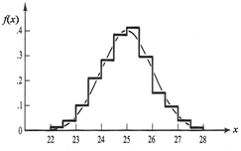
Random Errors
Repeated measurements and distribution of data
Suppose you are doing an experiment to measure a physical quantity x. (e.g. in a free fall experiment, you measure the falling time t for a fixed height.) When repeating the measurement, very likely, you get a slightly different result in each repetition.
Suppose you repeat n times and obtained data: The average value is almost always the best quantity to be used to describe the “true value”. The data can be described in a histogram of frequency distribution: To plot the histogram, the horizontal scale (for x) is divided into small intervals of equal size (called bins in Excel). The vertical scale is for the (normalized) number of observations with x falling inside each bin.
Frequency distribution of x
Value of x

Slide 40
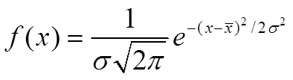
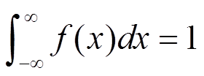
Data Distribution
A smooth plot can be obtained only for n→ ∞. Very often we can use a normal distribution (also called Gaussian distribution) to fit the histogram (the smooth curve shown in the previous figure):
where
Notes:
σ sigma sigma

Slide 41
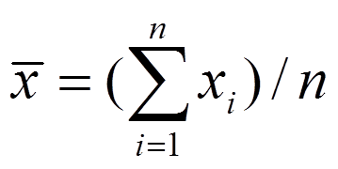
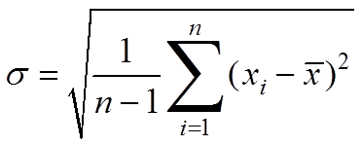
Mean and standard deviation
According to Sampling Theory, the mean is the best estimate of your measurement of x, and
is the best estimate of the standard deviation (also called the true standard deviation)
To quantify the amount of variation or dispersion of a set of data values
Notes:
quantify the amount of variation or dispersion of a set of data values

Slide 42
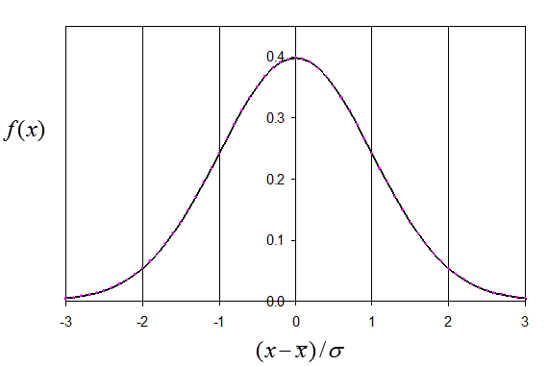


Mean and standard deviation
The area under the normal distribution curve in region is 0.68.
This means that if you repeat the measurement one more time, you have 68% chance of getting a new value of x falling within the interval
0.68

Slide 43
Standard Error
The precision of the mean is indicated by the standard error (also called the standard deviation of the mean)
Once the standard deviation has been calculated for n measurements, it is very easy to calculate the standard error $δ$ using
$$δ=\frac{σ}{\sqrt{n}}$$
If one repeat the entire series of n measurements and get a second mean, how close can one expect it to come to the first mean?
There is 68% chance that the second mean should fall within $±δ$ from the first mean.
Note that more measurement will not change the standard deviation.

Slide 44



Standard and Probable error
Meaning of standard error:
Assume that the data set can be described by normal distribution. Then when you repeat the measurements and obtain another data set, you have 68% chance to get a new value of falling within the interval:
Note: Some people prefer using “probable error” δx_{p}, which is defined by
δx_{p} ≅ 0.67δx.
So that when you repeat the measurements, you have ~50% chance to get a new value of falling within the interval:

Slide 45

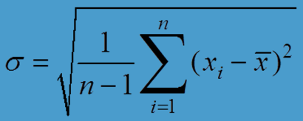

Single measurement
What if n=1, that is you measured x only once. Average is just x₁.
What is its error?
One can’t calculate the error by statistical methods, but there is still equipment error.
The finest scale division always provides a fundamental lower limit to the uncertainty.
No amount of repetition of a meter stick reading will give a precision of a micron!
Report your data as , where is now the estimated equipment error.

Slide 46

Presentation of data
(5) How to present data and error? Present your result as:
If the error is dominated by instrumental or systematic errors, or you repeat the measurement only for a few times, then there is no point to calculate the random error. In this case, just use the instrumental error or best-guessed systematic error for the data.
1. The error should be quoted to one (or at most two) significant figure(s) only.
2. The datum should have significant figures consistent with its error. Do not present every digits output by your calculator or computer!

Slide 47



Presentation of data
e.g.1: Suppose the Excel program give you = 1.23344672 and = 0.04556533, you should present your result as 1.23±0.05 (or 1.233±0.046).
e.g.2: The CODATA (The Committee on Data for Science and Technology) recommended value of elementary charge:
or in concise form, (http://physics.nist.gov/cuu/Constants/index.html)
You can also use the percentage error but be careful when using this format.
Note: always present data in scientific format.

Slide 48
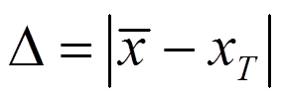
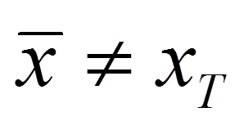


Comparing Results
(6) Is your experiment satisfactory?
Discrepancy: Beside presenting your results with the estimated error, if a theory (a law) exists to predict an expected value x_{T}, then you should also consider the discrepancy: . Very likely, in your experiment.
1. If , we say we have verified the theory within the experimental errors. To further test the theory, we need to improve the experimental design to get a smaller .
2. If , then the theory may be wrong or the experiment was not properly designed and you’ll need to check both the theory and experiment carefully to look for an explanation of the discrepancy. New law or theory of physics may be discovered when one observes such a discrepancy.
Notes:
discrepancy
dɪsˈkrɛp(ə)nsi/
noun
an illogical or surprising lack of compatibility or similarity between two or more facts.

Slide 49

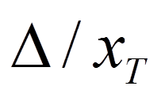
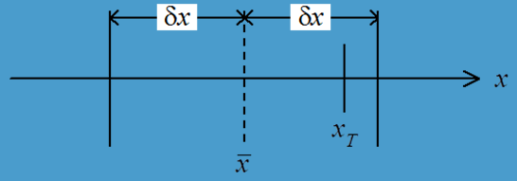
Comparing Results
Comparing result with accepted value:
In this physics labs, you will verify various laws or repeat some well-known experiments. In many cases, what you measure has an accepted value x_{T} (available in textbooks or webpage like http://physics.nist.gov/cuu/Constants/index.html).
1. If (Fig. 4), you can say
you have just repeated the experiment with satisfactory result, or
your experimental result agrees with the accepted value.
Present (in %) in your conclusion. Normally, in this lab, your result is satisfactory if the discrepancy is < 10% for most experiments.
Fig. 4

Slide 50

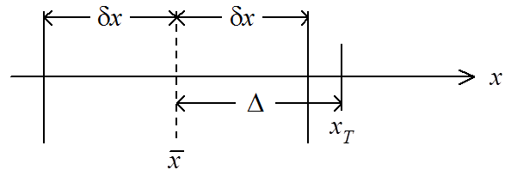
Comparing Results
2. If (Fig. 5), then the discrepancy is significant. This indicates that you made a mistake or there exist some systematic errors in the equipment.
Fig. 5
Not Acceptable！

Slide 51

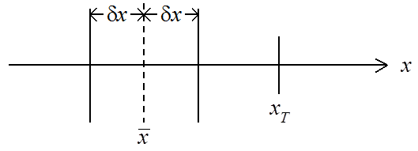
Accuracy vs precision
(7) Accuracy vs precision:
Accuracy: It measures how close the experimental result from the “true” value.
Precision: It measures how well the experimental result is determined without reference to any “true” value. Compare Fig. 4 and Fig. 6:
Result in Fig. 6 is more precise than that in Fig. 4, probably due to better equipment (but not properly calibrated). However, result in Fig. 4 is more accurate than that in Fig. 6.
Good result should be both accurate and precise (i.e., Δ < δx << ).
Fig. 4
Fig. 6

Slide 52
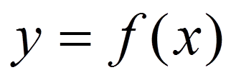
Fitting a curve to data
(8) Fitting a function to the experimental data
Very often we need to check a theory by measuring a quantity y as a function of x and verify an expression: .
It is easier to handle and visualize a linear plot.
So usually we try to convert the expression into a linear equation and plot a linear graph.
Least square fit to a linear graph:
Given: n data points: (x_{i},y_{i}), i = 1, 2,…n.

Slide 53

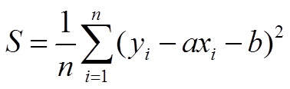


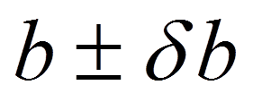
Linear Least Square Fit
If you try to verify the linear equation: , then a and b can be obtained by minimizing the mean-square deviation
where is the deviation of the point (x_{i}, y_{i}) from the straight line.
In CAPSTONE, the minimization and the fitting are done by a built-in program and to give the slope and intercept .

Slide 54
Linear Least Square Fit
The best estimate of the uncertainty in the measurement of y is
The uncertainties in a and b are
$δ_{a}=δ_{y}\sqrt{\frac{n}{∆}}$ ;
$δ_{b}=δ_{y}\sqrt{\frac{\sum_{i=1}^{n}{x_{i}^{2}}}{∆}}$, where $∆=n\sum_{i=1}^{n}{x_{i}^{2}}−{(\sum_{i=1}^{n}{x_{i}})}^{2}$
$$δ_{y}=\sqrt{\frac{1}{n−2}\sum_{i=1}^{n}{{(y_{i}−ax_{i}−b)}^{2}}}$$

Slide 55

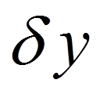
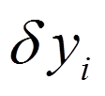
Linear Least Square Fit
The formulae used in CAPSTONE were derived with the following assumptions:
1. The x-values are assumed to be exact or with negligible uncertainty .
2. The y-values are subject to random errors only.
3. The y-values measured for a fixed x follow a normal distribution.
4. is the same for all x-values.
You can find the derivation in the reference books listed.
We show here only the “unweighted” linear least square fit. If you repeat measurements of y many times for each x and obtained , then you better use the weighted least square analysis.

Slide 56
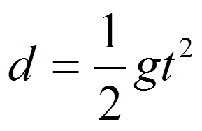

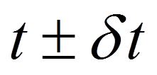
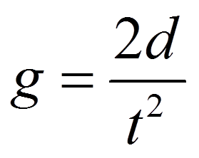

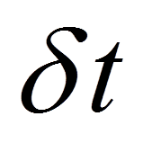
Propagation of error
(9) Propagation of error
Very often you need to determine a physical quantity indirectly.
e.g., in a free fall experiment, you need to verify , where d is the falling height, and t is the falling time.
In the experiment, you measure d and t, and estimate their errors: and
You then obtain g by the equation .
The error in g is due to errors in d and t. We can determine in terms of and .

Slide 57
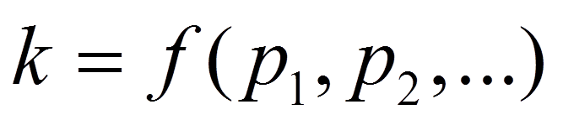

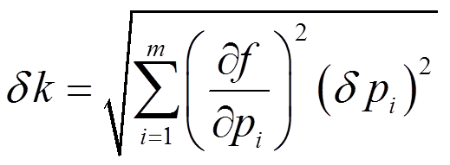
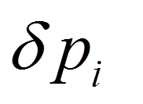
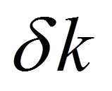
Propagation of error
Suppose you need to calculate the error of a physical quantity k by a given expression .
In the experiment, you can measure the independent (uncorrelated) quantities and estimate their errors: .
Assume all independent quantities are subject to random error and normal distributions. Then by sampling theory (see reference for a derivation), the (standard) error of k is given by
This tells you how the errors affect .
In the case，$x=f\left(u,v\right), δx=\sqrt{\left(δu\right)2\left(\frac{df}{du}\right)2+\left(δv\right)2\left(\frac{df}{dv}\right)2}$

Slide 58
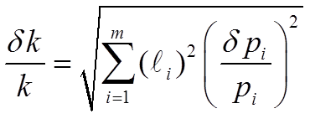
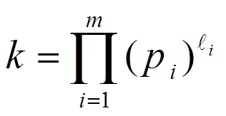
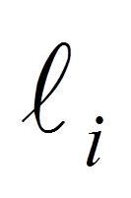
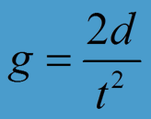
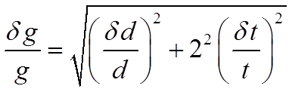
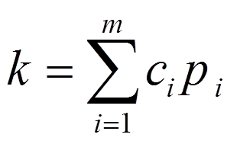
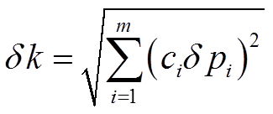
Propagation of error
Special cases in error propagation: For , (with constant ), .
e.g., in a free fall experiment, . The error of g is : .
For , where c_{i} are constant coefficients. Then .
Based on these formulae, we see that it is sufficient to consider only those parameters that have significant errors.
Try to identify major sources of errors for each experiment.

Slide 59
Accuracy of our equipment
(10) Accuracy of our equipment
Each equipment you use in the Phys Labs was calibrated by the manufacturer and its instrument error is given in the manual that comes with the equipment. Better calibration can be done only if appropriate standards are available (e.g. you need a standard voltage source to calibrate a voltmeter).
Refer to the Sensor specifications for the instrument error of our equipment.

Slide 60



Experimental Strategy
(11) Repeated measurements?
Now we know that the random error can be determined and minimized by repeated measurements. But we have to compromise between data precision and time. Consider the free fall experiment again. Suppose you have time to make 20 measurements. How do you plan the experiment to obtain g?
Option 1: Fix d and measure t 20 times. Use the average falling time to calculate g by .
Option 2: For each d, measure t and repeat once. Use average value to calculate g. Repeat measurements for different d and use as the final answer.

Slide 61



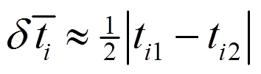
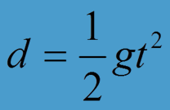
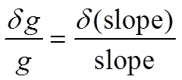
Experimental Strategy
Option 3: Make measurements like Option 2, but plot d against and determine g from the slope of the straight line. Here, the data are , i=1, 2,..,10.
And
For simplicity, take .
Option 3 is usually the best choice because
the plot can help us to avoid systematic error (in d for this free fall experiment);
you can verify the theory through the formula instead through a value;
it is easy to identify wrong data if they are far from the straight line. You can now calculate the error of g: , where the slope and d(slope) are obtained by curve fitting.

Slide 62
Thank you and good luck in your experiments!

